Slide 1

Task Management System
The Task Management System (TMS) is a sophisticated, centralized platform to optimize task management processes, enhance streamline approval workflows. By addressing challenges such as limited visibility and inefficient communication, TMS ensures timely task delivery and helps in effective collaboration among teams.
Purpose
Enable task plan submission and management.
Streamline manager review and approvals.
Provide real-time task visibility and analytics.
Support data-driven incisive decisions.
Key Objectives
Real-time task and team performance visibility.
Efficient task and approval workflows.
Enhanced communication via notifications.
Secure role-based access.
Actionable insights via reports/dashboards.
System Capabilities
Real-time task tracking with visuals.
Structured approval workflows.
Automated alerts for actions/deadlines.
Secure, scalable system with role-based access.

Slide 2
Core Functionalities
1. Task Management
Create and assign tasks with specific parameters.
Monitor task progress with status indicators and milestones.
Manage task lifecycle from creation to completion, with archiving.
2. Action Plan Management
Employees submit daily task plans with timelines.
Track plan statuses (e.g., Started, In Progress, Completed, Under Approval).
Managers review, approve, or reject plans with feedback.
3. Approval Workflows
Employees submit task completion requests.
Managers review requests, approving or rejecting with comments.
Automated notifications for pending actions and updates.
4. Reporting and Analytics
Generate reports on task progress, team, and individual performance.
Export data in PDF, CSV, or Excel formats.
Role-specific dashboards with key metrics.
Benefits
Managers can easily review with less paperwork, clear team reports, and quick fixes for delays. Employees get clear tasks for better focus, visible recognition of their work, and fast, helpful feedback.

Slide 3
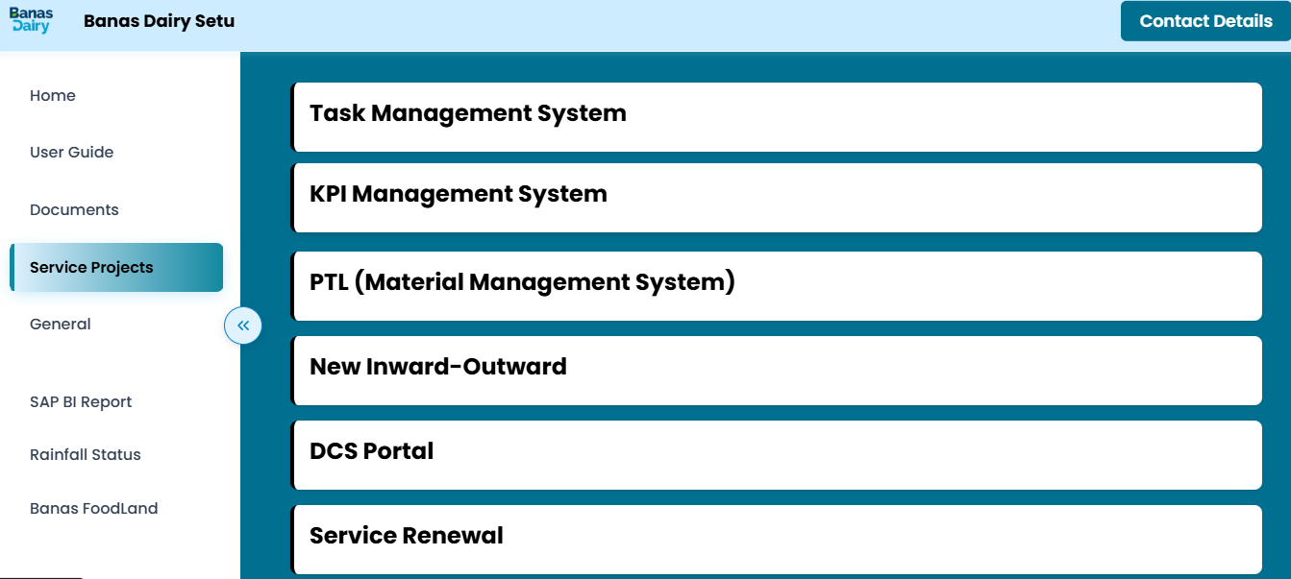
1.Open Banas Setu and in Service Projects click on this to open the Login Portal of Task management System.
2.Open web browser and type the following IP- 10.40.0.33:3002 in the address bar and press enter key to redirect to the login portal of Task Management System.

Slide 4

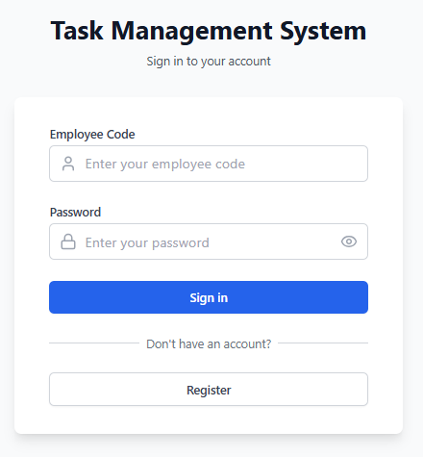
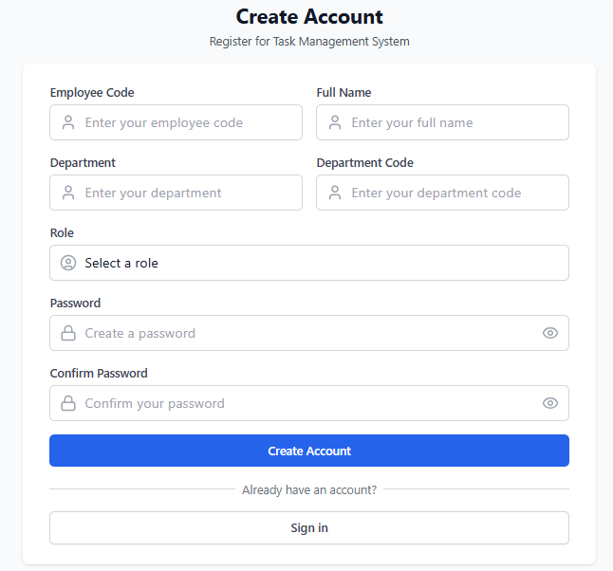
This is the Login/Register page where employees can securely sign in or create an account (if they are new users) to access the main platform.

Slide 5
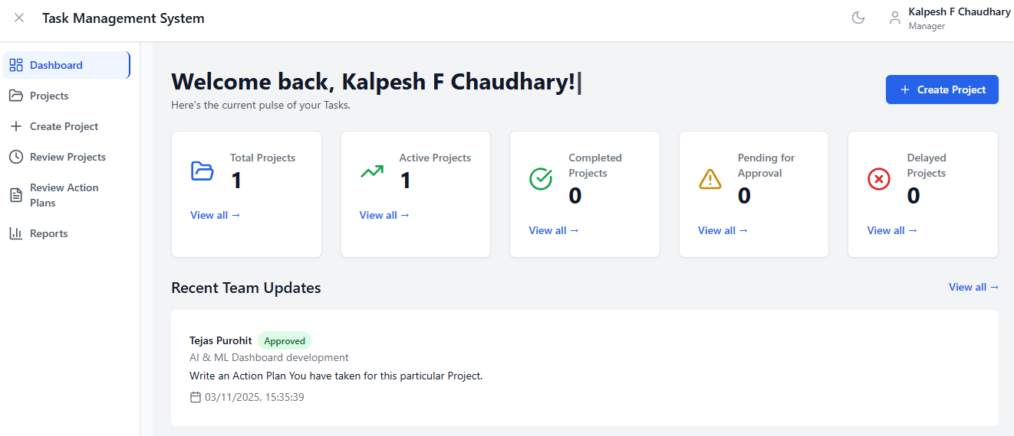
In this Dashboard section, Managers can view the status of all Projects and access detailed action plans.

Slide 6
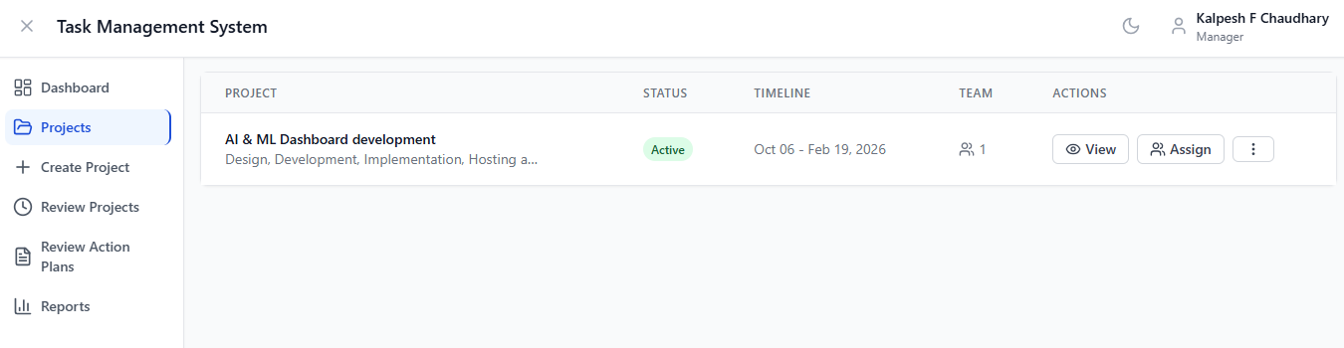
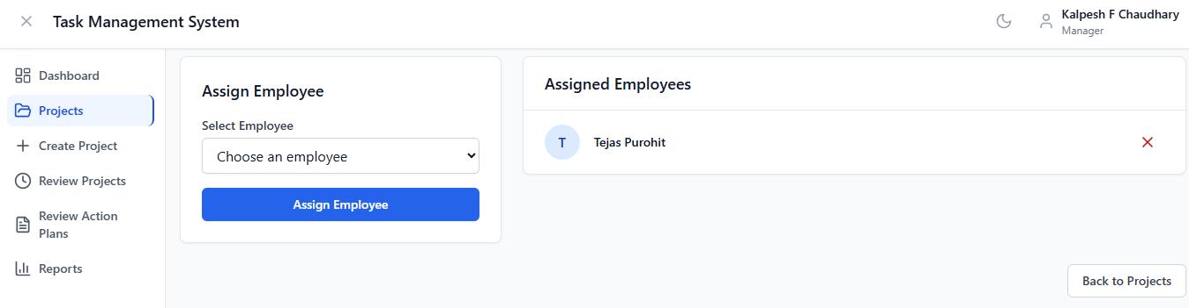
Managers can assign employees to a particular project from the dropdown.
In this section, Managers can view and manage all projects they have created.

Slide 7
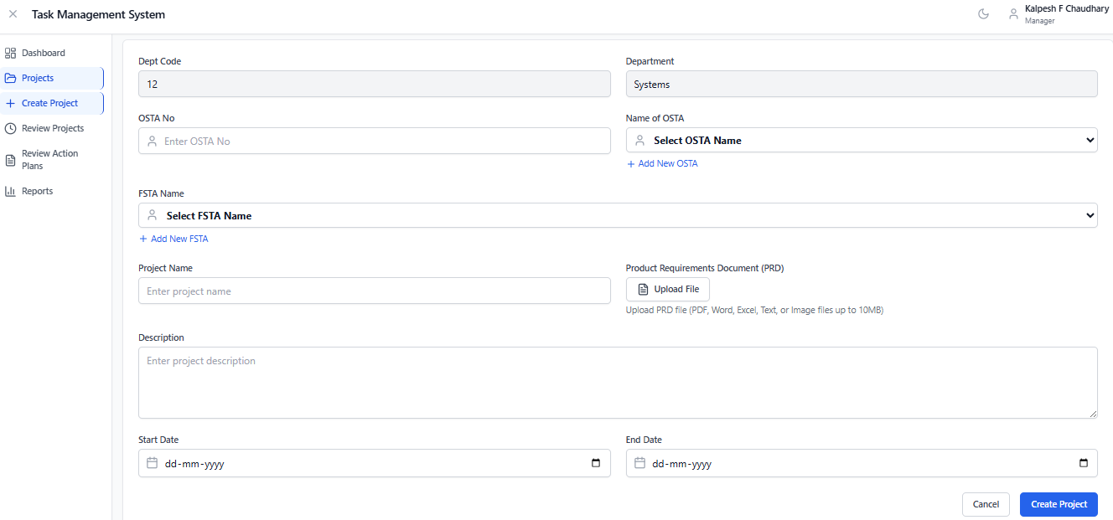
In this section, managers can initiate new projects aligned with OSTA and FSTA frameworks, including detailed descriptions and set deadlines for each project.
These fields will fill in automatically based on the user’s department.

Slide 8
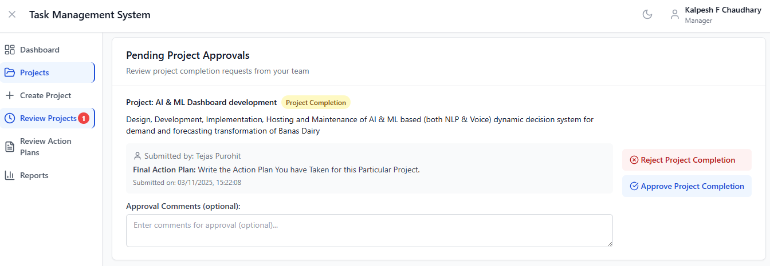
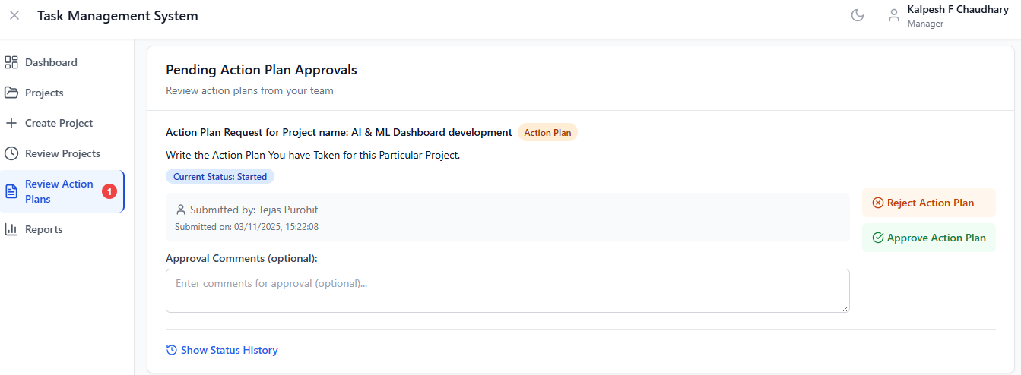
In this Section, Managers can review Project approvals submitted by employees.
In this Section, Managers can review Action plans submitted by employees.

Slide 9
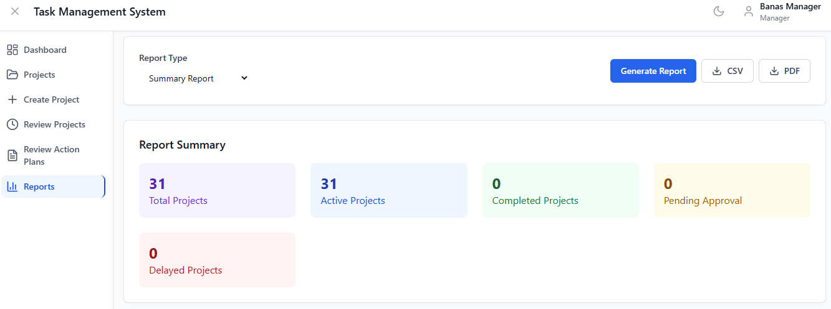
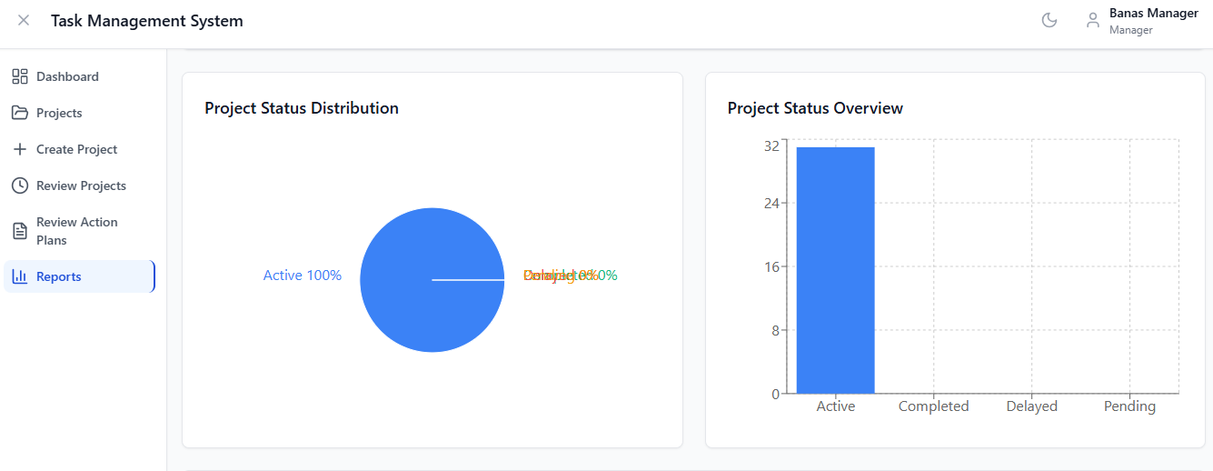
In this Section, Managers can view project reports, analyze bar charts, and download summaries for all projects or individual projects in PDF and Excel format.
By Clicking in the Generate report the Reports Summary will be Generated

Slide 10
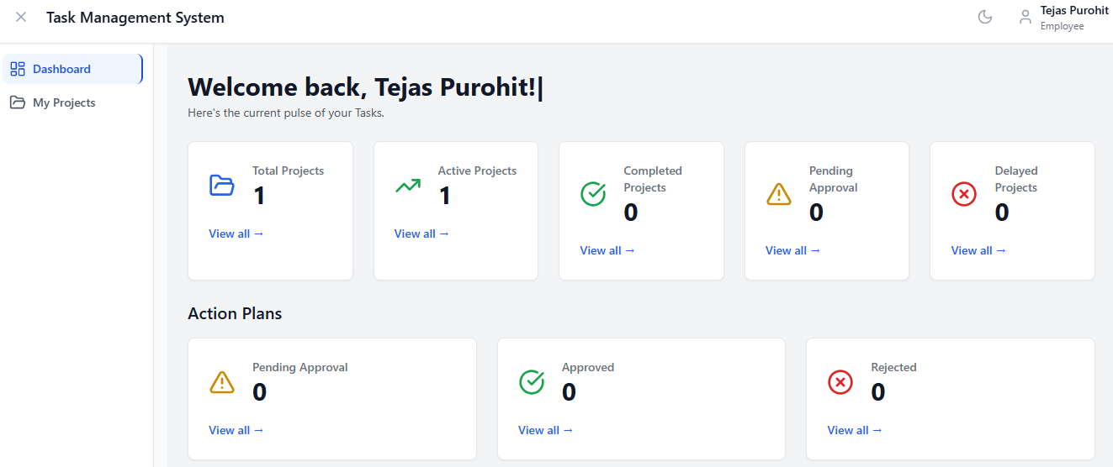
This is the Employee Dashboard, where employees can view all projects assigned to them, access detailed project information, and review the action plans they have submitted for each specific project.

Slide 11
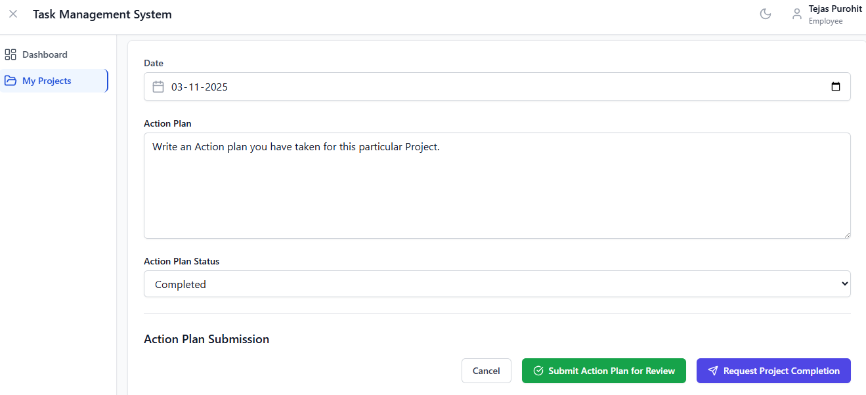
In this section, team members can submit action plans for their assigned projects and request project completion approval, which will be reviewed and authorized by the manager.

Slide 12
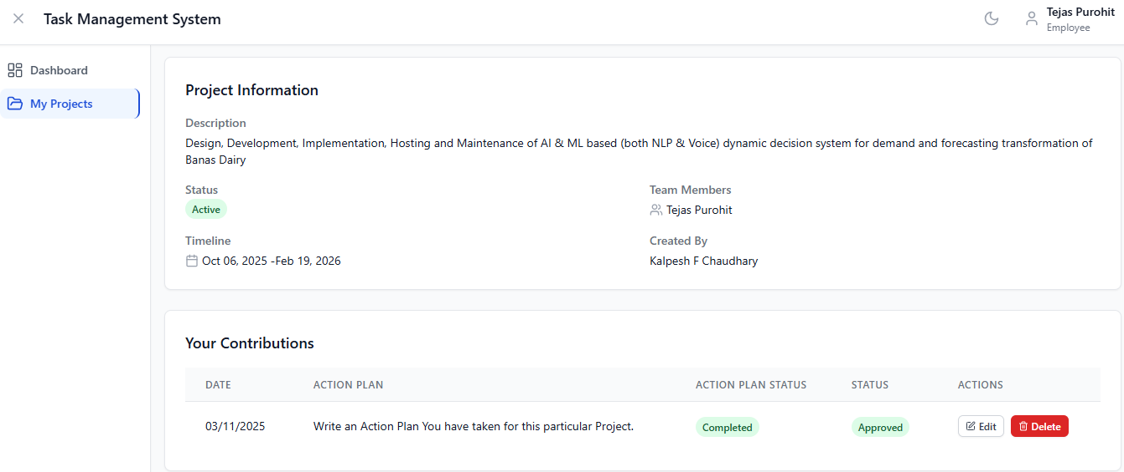
In this Section, employees can view all project details assigned to them, as well as the action plans they have submitted and their approval or rejection status.

